Slide 1

Formal Verification of Browser Fingerprinting and Mitigation with Inlined Reference Monitors
Nathan Joslin, Phu H. Phung, Luan Viet Nguyen

Slide 2
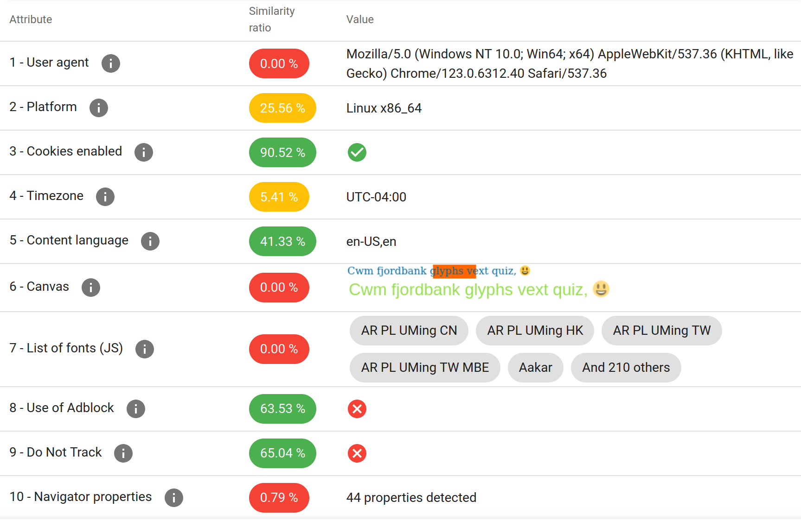
What is Browser Fingerprinting?
Definition: An aggregation of browser attributes
Stateless: Unlike cookies, no information is saved client-side
Silent: User is completely unaware
Source: amiunique.org
Notes:
Digital fingerprinting is a technique used to create unique identifiers by aggregating a variety of attributes associated with a device.

Slide 3

Applications and Motivations
Positive
Malicious
Ad Fraud Prevention
Bot Detection
Multi-Factor Auth
Cross-site Tracking
Malware Targeting
Social Media Linking
Duality
Involuntary Tracking
Voluntary MFA
Fraud Prevention

Slide 4
Rising Popularity
Fingerprinting the Fingerprinters
Iqbal et al. (2021)
Estimated Usage:
30.60% of Alexa top 1K
10.18% of Alexa top 100K
By Category:
14% of News sites
6% of Shopping
Other:
2,349 domains serving scripts
3.78% considered tracking by Disconnect
The Double Edged Sword
Senol, Ukani et al. (2024)
Estimated Usage:
25.75% of CrUX top 1K
8.9% of CrUX top 100K
By Category:
9.2% of Login Pages
12.5% of Sign-up Pages
Other:
60% of scripts use the Canvas API

Slide 5
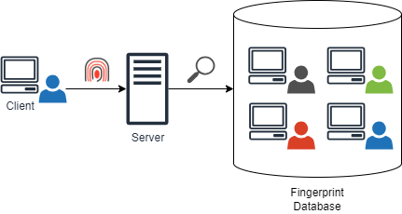
Fingerprinting Mitigation
Policy Decision Making
Machine Learning Based
Developer Defined Heuristics
Enforcement Methods
API Blocking
Randomization
Normalization
Notes:
Two aspects of Fingerprinting Mitigation
Policy Decision Making: “When do we mitigate”
Policy Enforcement: “How do we mitigate”
We’re concerned about the reliability of enforcement

Slide 6
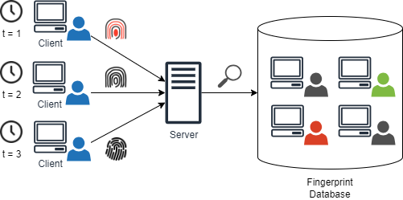
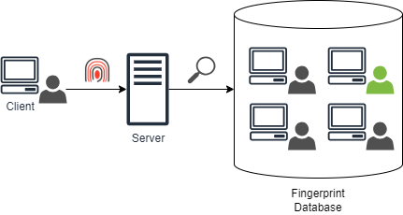
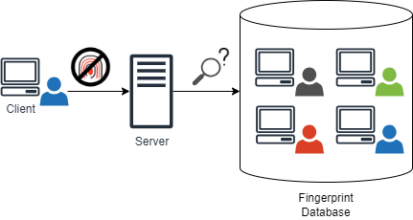
Mitigation Approaches
No Mitigation
Randomization
Normalization
API Blocking
Notes:
Shows the effects of mitigation approaches on fingerprinting schemes
Normalization: Hide in the Crowd
Randomization: Moving Target
API Blocking: Prevent function execution

Slide 7
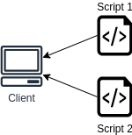
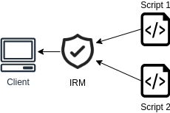
Inlined Reference Monitors
Language-based security approach
Rewrite/Weave security policies into the application
Runtime interception of function calls or property accesses

Slide 8
Building the Components

Slide 9
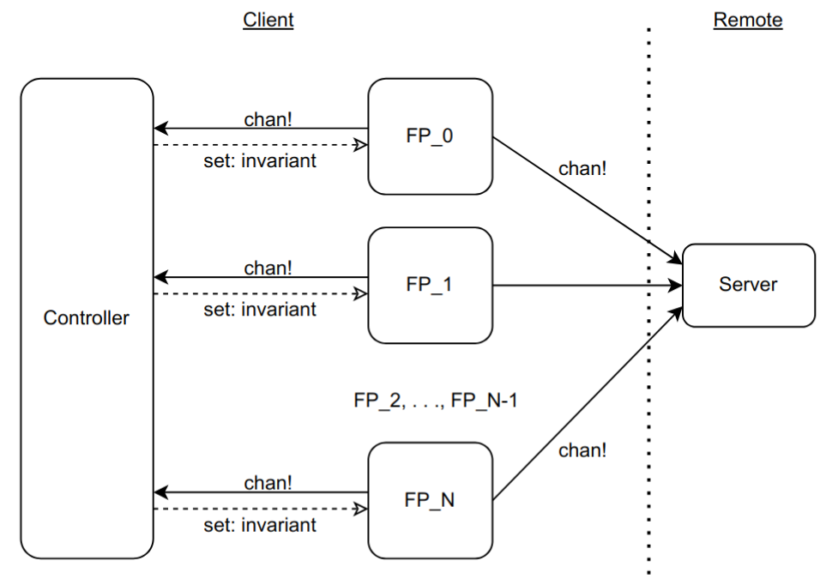
System Overview

Slide 10
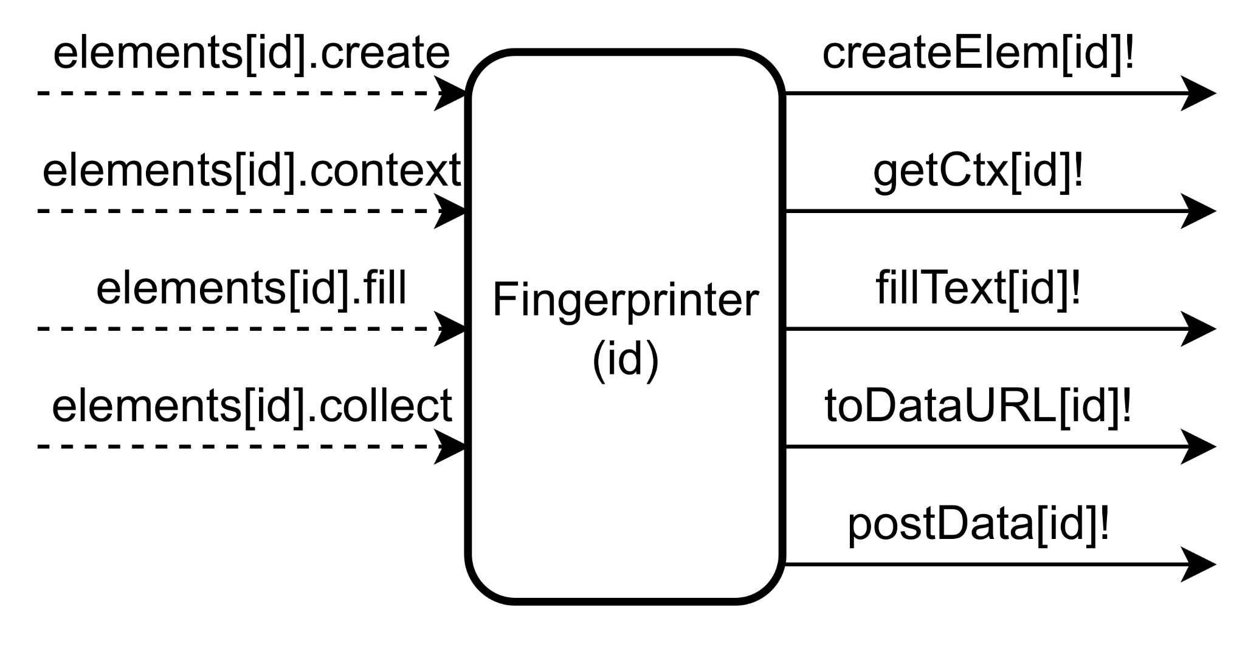
Fingerprinter: Overview
Description:
Models a canvas fingerprinting script
Based off of open-source libraries and related research
Attempts to make function calls that are intercepted by the Controller
𝑥 : Functions Monitored
𝑦 : Fingerprinter Components
Input: Invariants set by the controller.
𝑓 (𝑥,𝑦) = 𝑥𝑦
Output: Send channel synchronizations.
𝑓(𝑥,𝑦) = 𝑥𝑦 + 𝑦

Slide 11
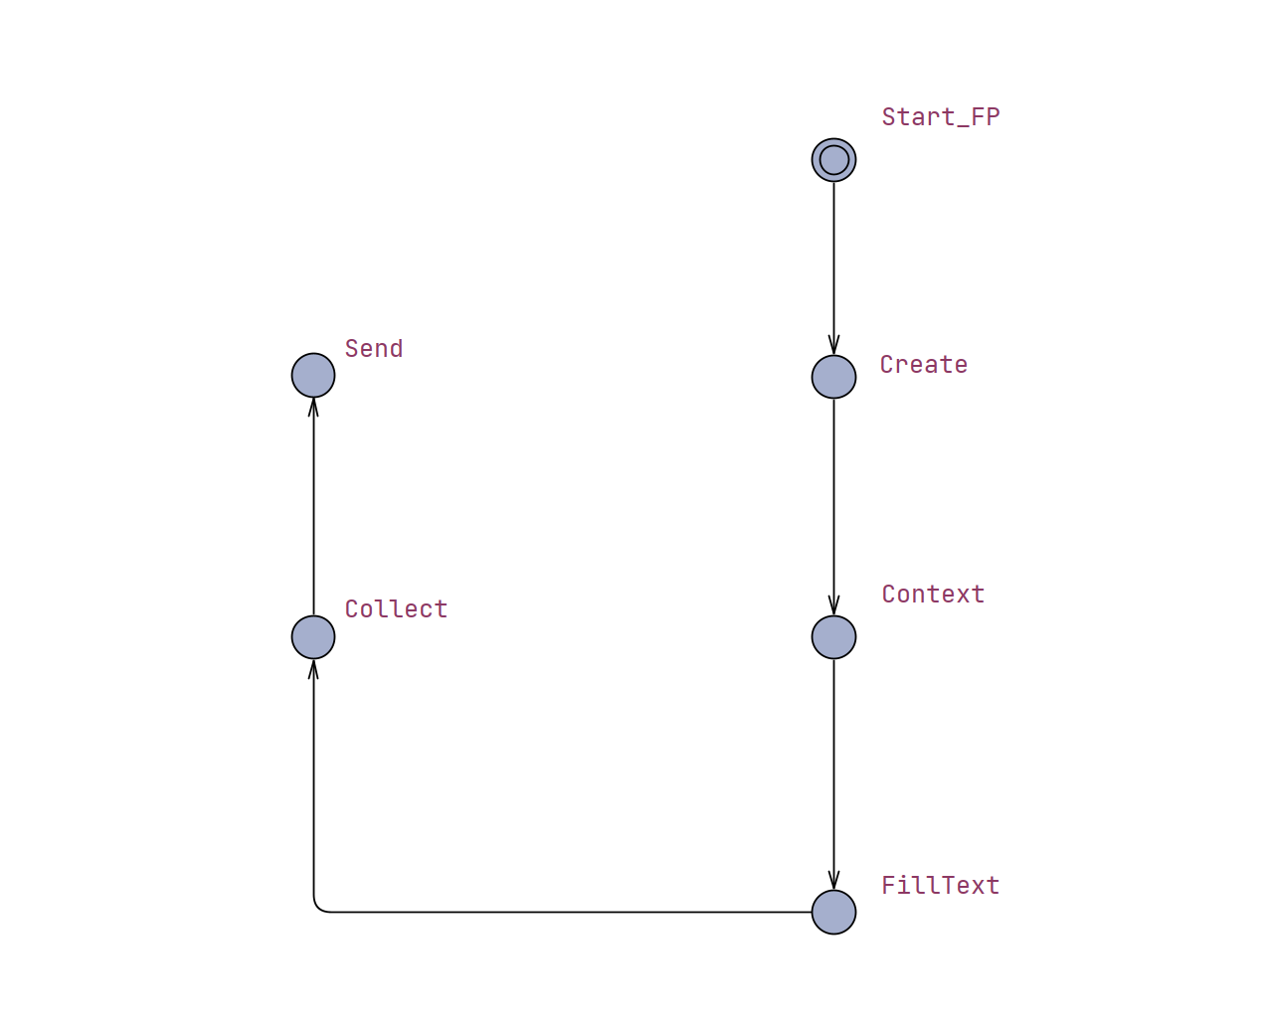
Main States
Create canvas element
Get canvas context
Draw on context
Collect value
Send to server
Notes:
Edges leading into states model function execution
States themselves represent successful completion of the function call

Slide 12
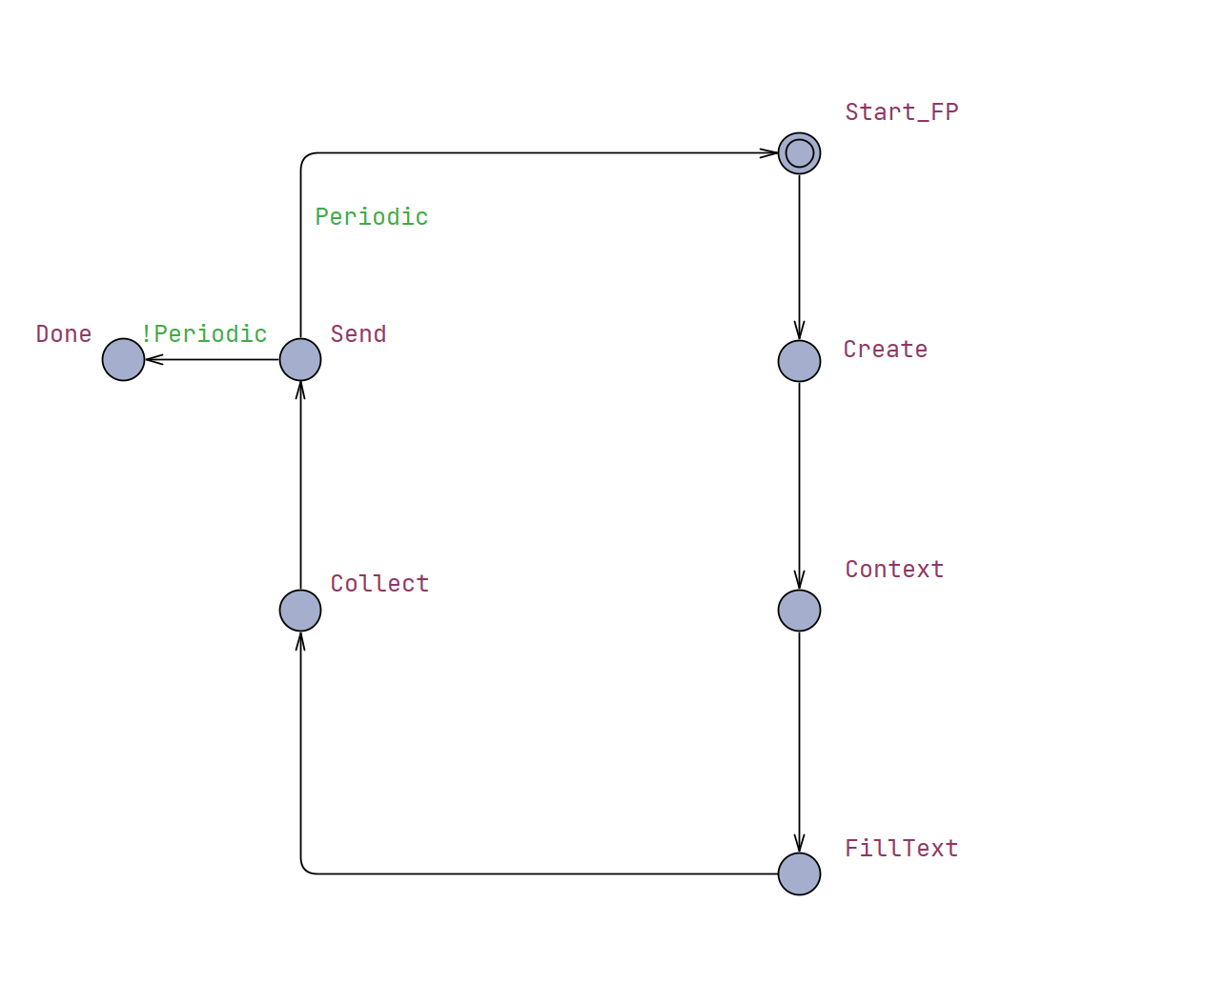
Periodicity
Supports modeling one-and-done and repetitive scripts
Helpful for analyzing behavior across runs
Easily modified to an integer value

Slide 13
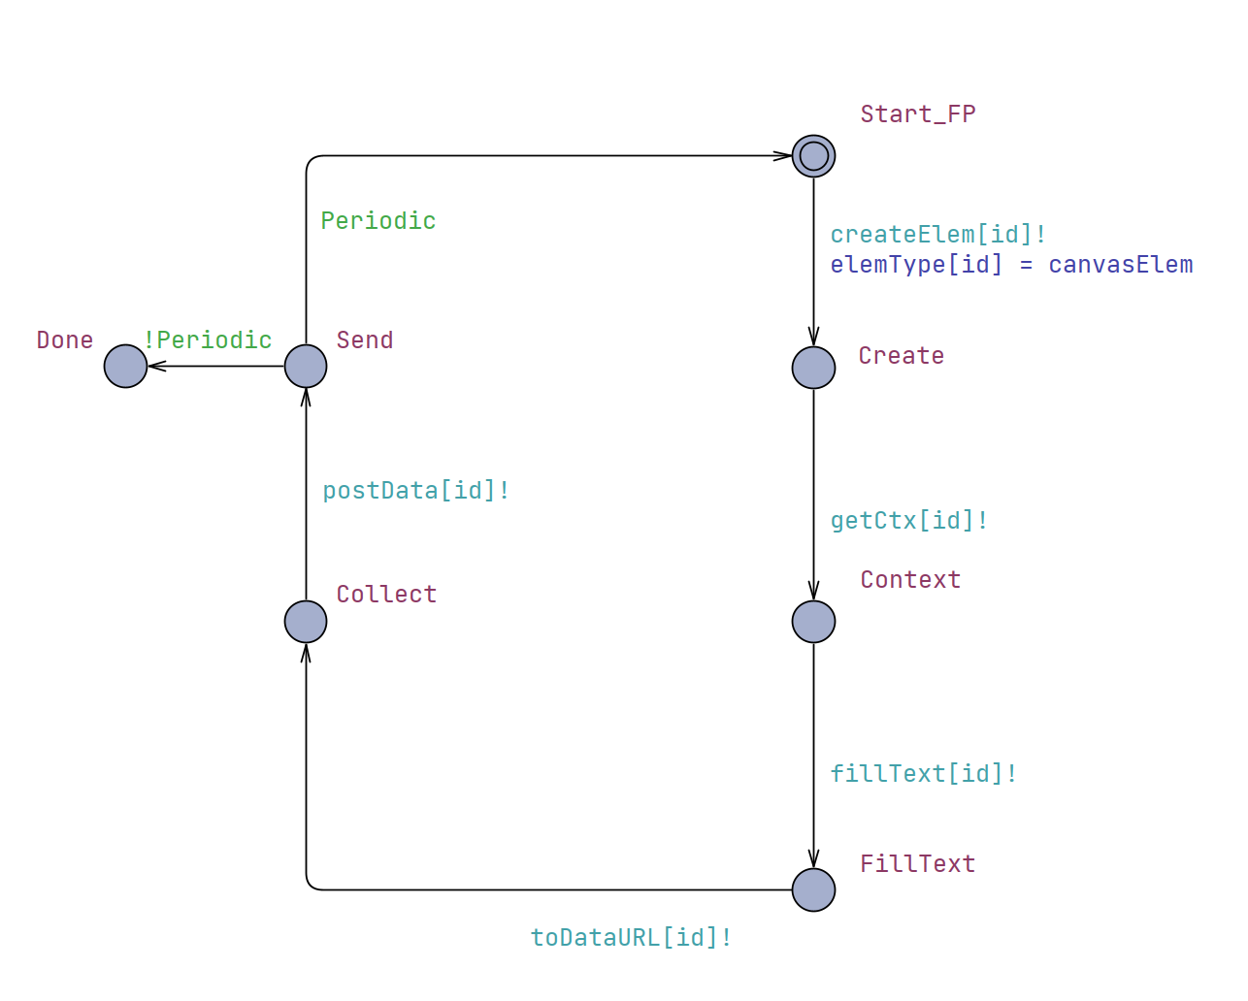
Synchronization Channels
Instrumentation for Controller
Models IRM function interception

Slide 14
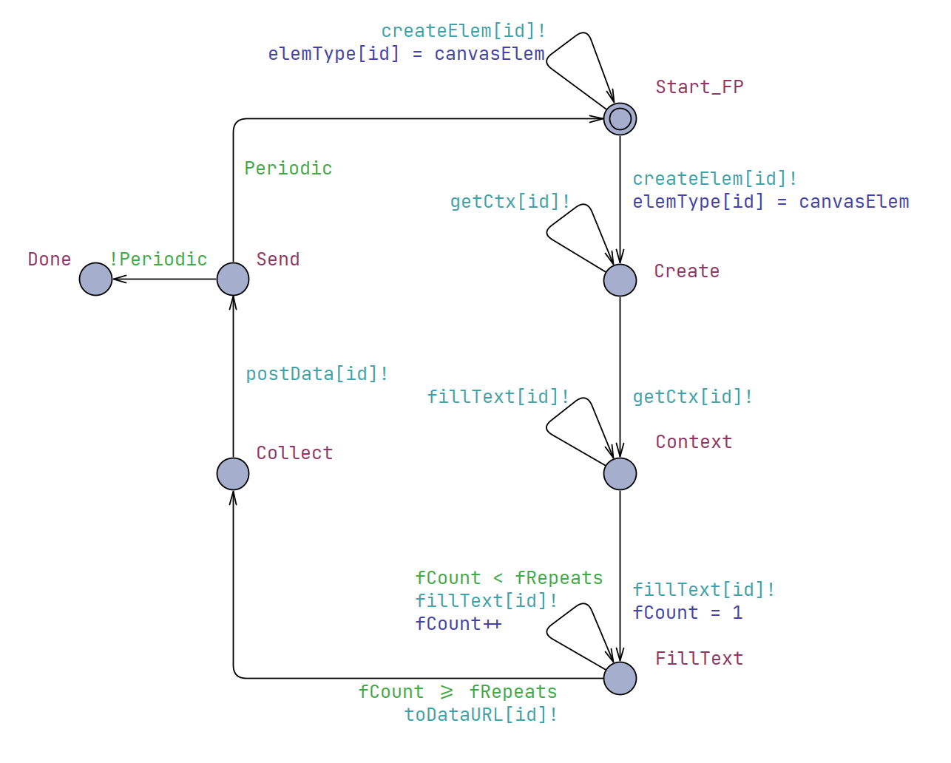
Persistent Loops
Supports a wider variety of scripts that may not be “well formed”
Notes:
Well formed or formed smartly, i.e. a script that intentionally makes function calls that aren’t necessary in an attempt to bypass defense mechanisms

Slide 15
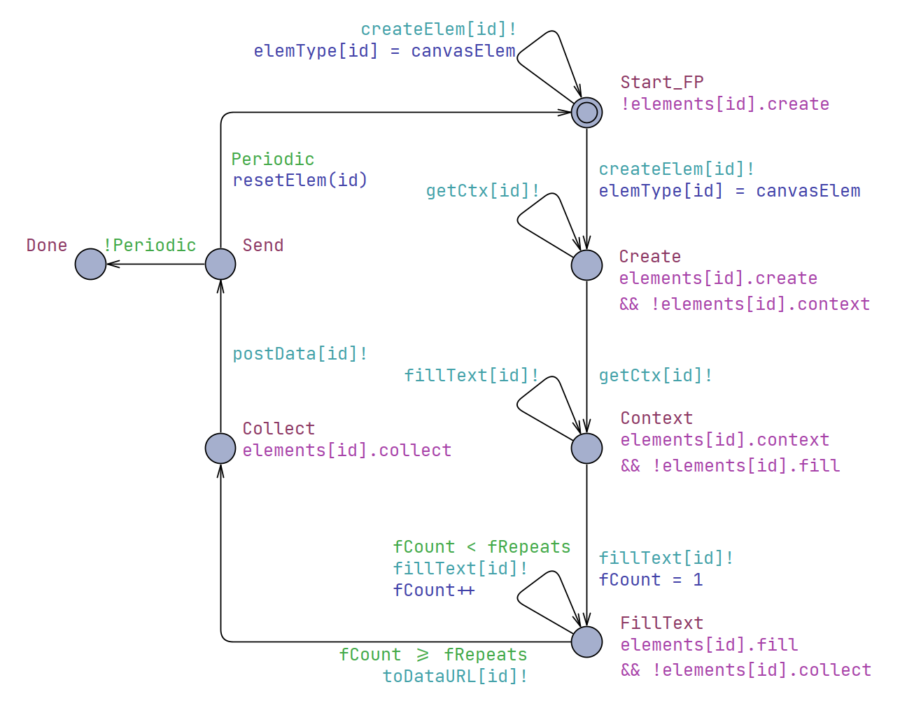
Controller Invariants
Instrumentation for Controller
Models IRM policy enforcement

Slide 16
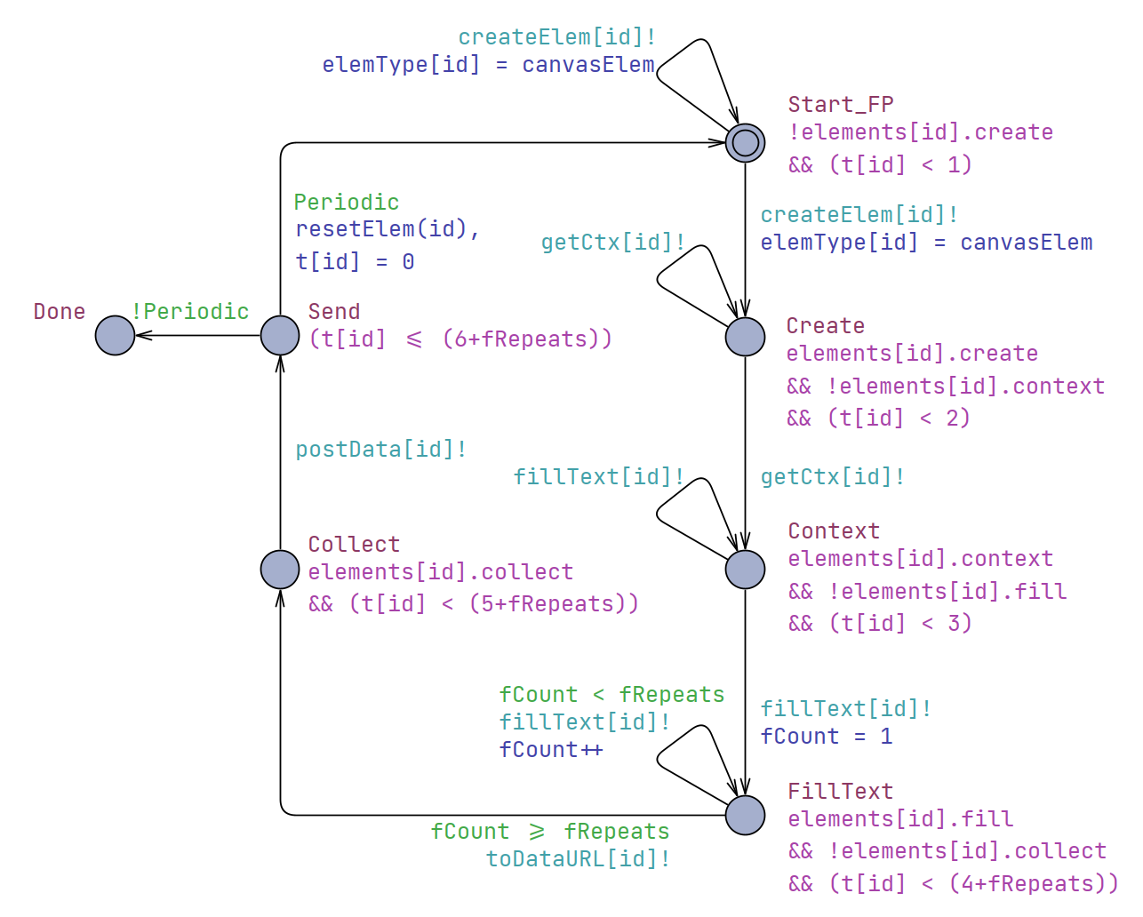
Timing Constraints
Ensures progression, if possible
Aids in evaluating liveness and reachability properties

Slide 17
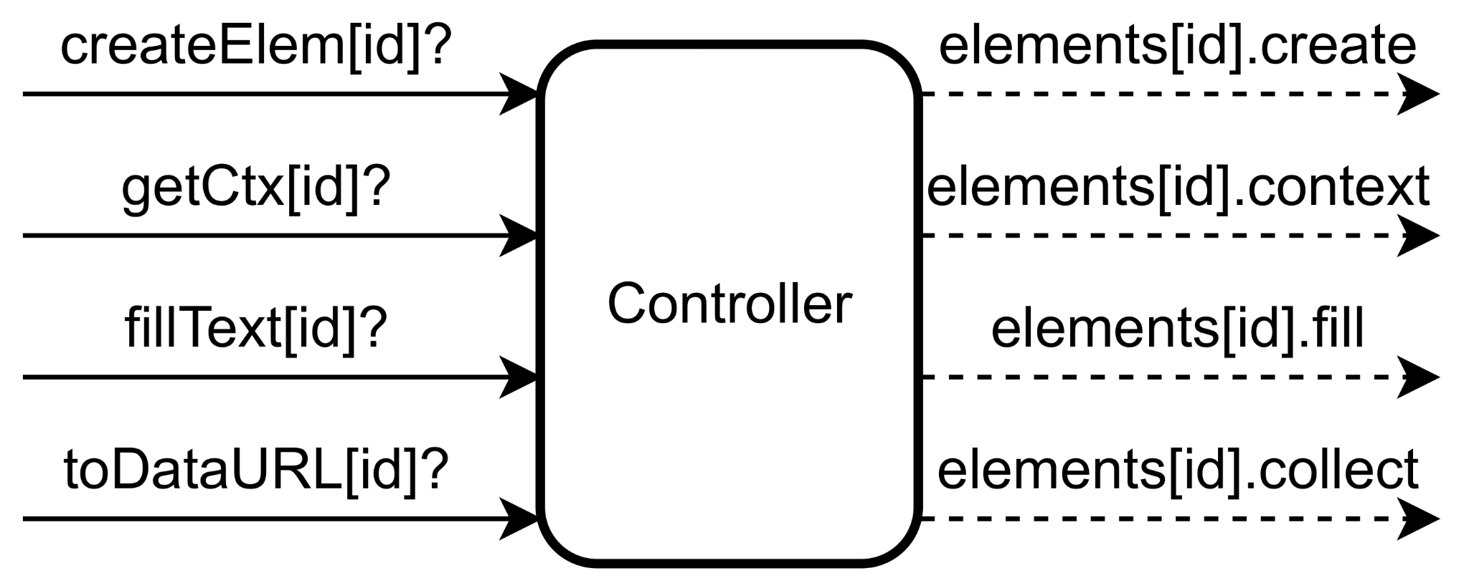
Controller: Overview
Description: An abstraction of an Inline Reference Monitor intercepting function calls.
Synchronizes with Fingerprinter components
𝑥 : Funcs Monitored
𝑦 : Fingerprinter Components
Input: Receive channel synchronizations.
𝑓 (𝑥,𝑦) = 𝑥𝑦
Output: Set state invariants.
𝑓(𝑥,𝑦) = 𝑥𝑦

Slide 18
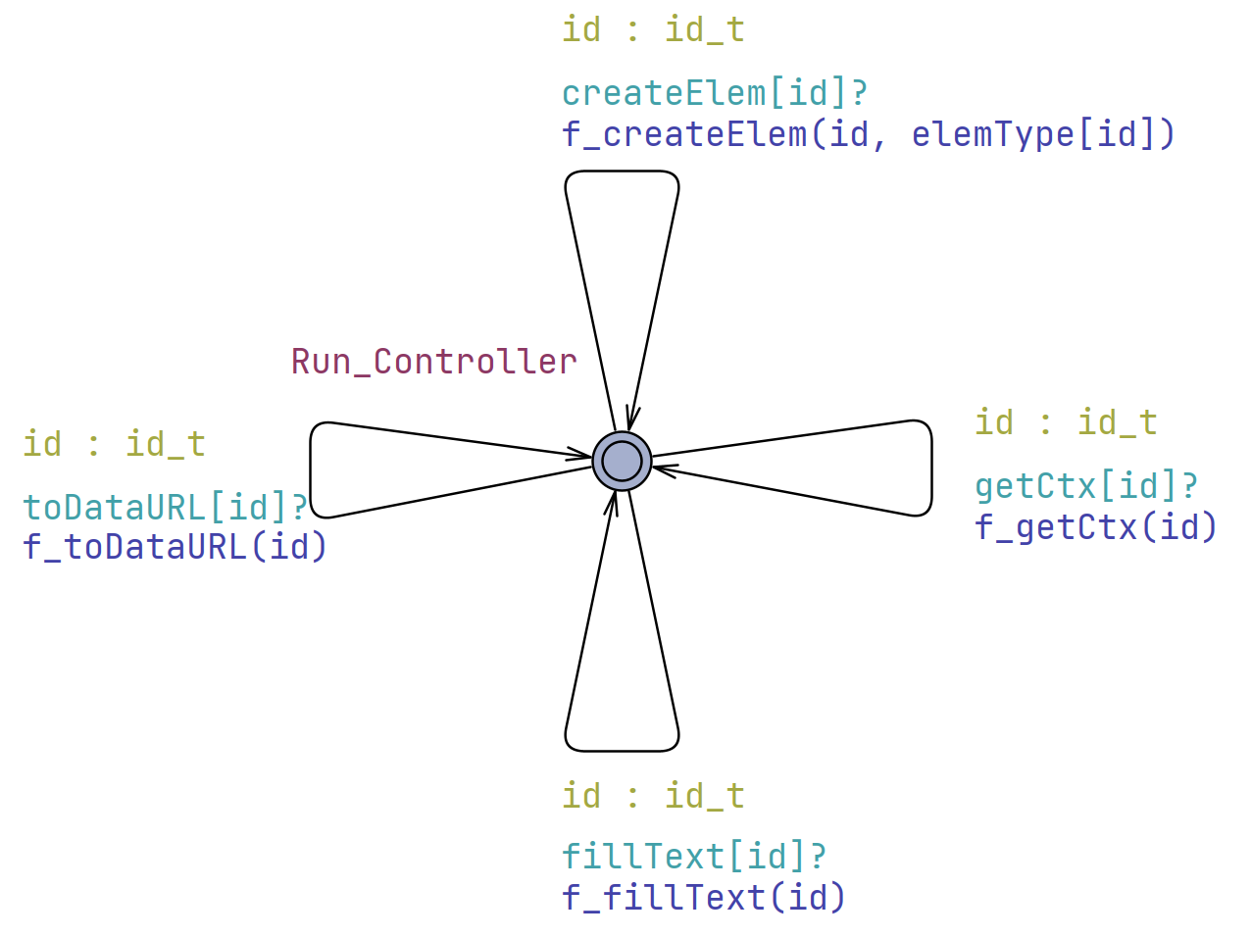
Controller: Timed Automata
Transitions:
One for each function monitored
Sync: Receive from any channel
Select: Sending component ID
Update: Policy Evaluation, or other actions

Slide 19
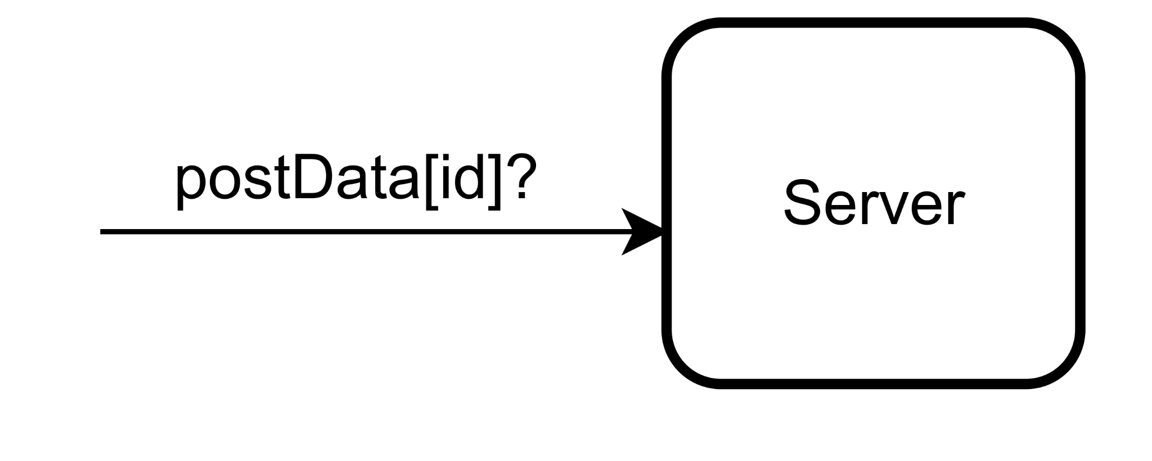
Server: Overview
Description:
Models a remote server and database
Allows fingerprint values to be evaluated over time
A comprehensive model of the remote components is out of scope
Input: Receive from data channel
Output: n/a, internally stores data

Slide 20
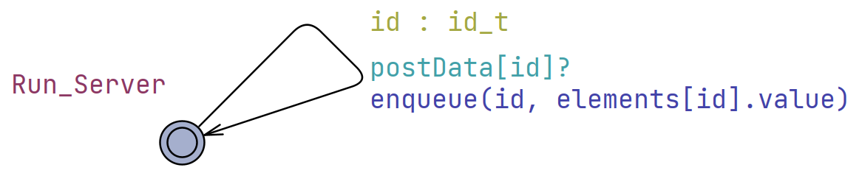
Server: Timed Automata
Transitions:
Sync: Receive from any channel
Select: Sending component ID
Update: Store data
One data channel for each Fingerprinter component
Notes:
Simply receives data from any fingerprinter component
Stores data into a queue
Distinct queues are defined for each fingerprinter component
Limited entries, such that an enqueue on a full queue first dequeues the oldest value (FIFO)

Slide 21
Requirements and Policy Configuration

Slide 22
Informal Requirements
FP_0
FP_1
FP_2
No Mitigation
Randomization
API Blocking
Allow fingerprints to be freely collected, without intervention from the Controller.
Allow fingerprints to be collected, but poison the data first.
Do not allow fingerprints to be collected whatsoever.

Slide 23
Policy Configuration
Policy | Type | FP_0 | FP_1 | FP_2
Create Element | Blocklist | False | False | False
Get Canvas Context | Blocklist | False | False | False
Fill Text | Blocklist | False | False | False
Collect Data | Blocklist | False | False | True
Poison Data | Allowlist | True | False | False
Notes:
The matrix approach is a caveat of UPPAAL
As an application, such as a browser extension, they could either be maps or array depending on implementation

Slide 24
Verifying Formal Safety and Liveness Properties

Slide 25
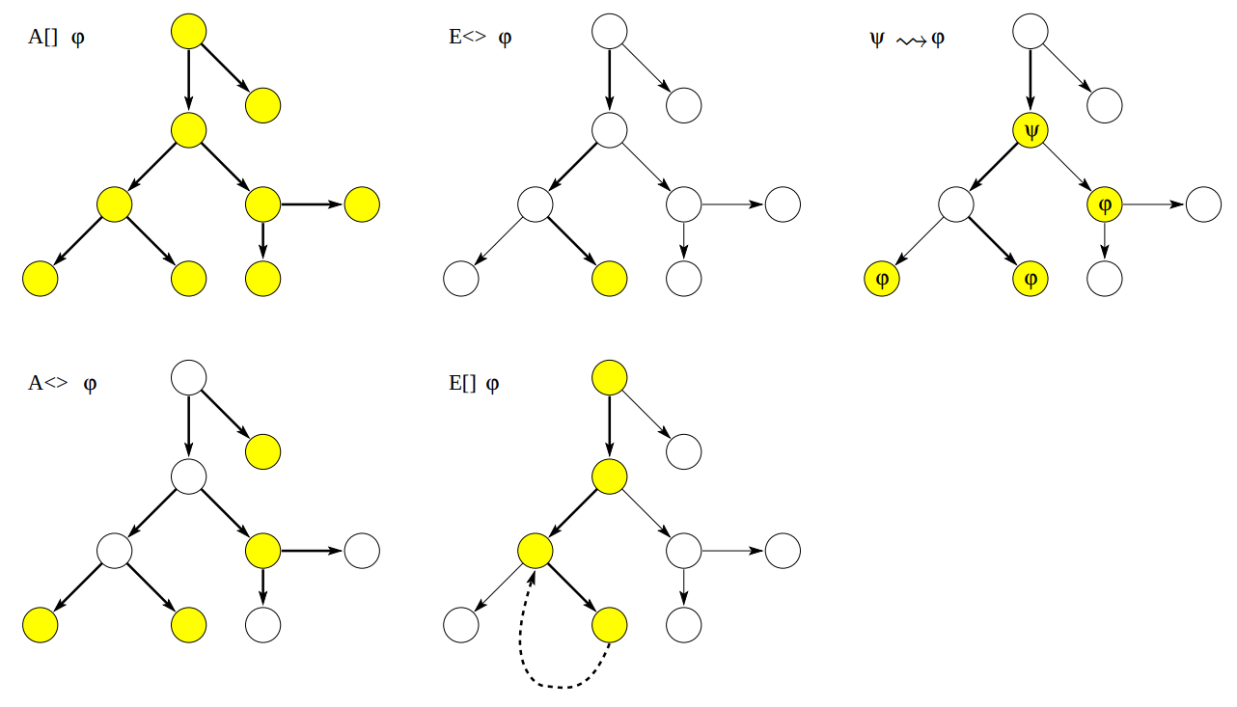
Safety Properties
A [ ] φ
E [ ] φ
Some property is invariantly true
φ is true in all reachable states
Some property is possibly always true
There should exist a maximal path where φ is always true
Source: UPPAAL Tutorial

Slide 26
Safety Properties
Prop. | Sat. | CTL/Meaning
A | True | A[ ] FP_0.Collect imply (elements[0].value > 0)
 |  | For all reachable states, component FP_0 being in the location Collect implies that its attribute value is not the default and is not poisoned.
B | True | A[ ] FP_1.Collect imply (elements[1].value < 0)
 |  | For all reachable states, component FP_1 being in the location Collect implies that its attribute value is poisoned.

Slide 27
Safety Properties
Prop. | Sat. | CTL/Meaning
C | True | A[ ] FP_2.Collect imply evalPolicy(p_toDataURL, 2)
 |  | For all reachable states, component FP_2 being in the location Collect implies the policy configuration allows it.
D | True | A[ ] !FP_2.Collect
 |  | For all reachable states, component FP_2 is never in the Collect location.
E | True | A[ ] Server.db[2].len == 0
 |  | For all reachable states, the server never receives fingerprint values from FP_2.

Slide 28
Liveness Properties
E <> φ
A <> φ
Ψ → φ
It is possible for some property to be satisfied
φ possibly can be satisfied by any reachable state
Something will eventually happen
φ is eventually satisfied
When some condition is met, eventually some property is satisfied
Whenever ψ is satisfied, eventually φ is satisfied
Source: UPPAAL Tutorial
Notes:
E<> is considered a reachability property by UPPAAL
A<> and → are considered liveness properties by UPPAAL

Slide 29
Liveness Properties
Prop. | Sat. | CTL/Meaning
F | True | E< > FP_0.Collect
 |  | The Collect location is reachable in the FP_0 component.
G | True | E< > FP_1.Collect
 |  | The Collect location is reachable in the FP_1 component.
H | False | E< > FP_2.Collect
 |  | The Collect location is not reachable in the FP_2 component.

Slide 30
Liveness Properties
Prop. | Sat. | CTL/Meaning
I | True | A<> ((Sever.db[0].len > 0) && (Server.db[0].entries[0] == Server.db[0].entries[1]) && (Server.db[0].entries[1] == Server.db[0].entries[2]))
 |  | Eventually all database entries for FP_0 are the same.
J | False | A<> ((Server.db[1].len > 0) && (Server.db[1].entries[0] == Server.db[1].entries[1]) && (Server.db[1].entries[1] == Server.db[1].entries[2]))
 |  | Eventually all database entries for FP_1 are the same.
Notes:
We don’t have a similar property for Fingerprinter Component 2 (FP_2) because it’s impossible for it to submit data, proved by property D

Slide 31
Wrapping Up
Contributions
Formal Models
Canvas Fingerprinter
IRM Controller
Evaluation of Models using CTL
Formal properties reflect requirements of mitigation methods
Extensible framework
Future Works
Extend our framework into a comprehensive model of real-world fingerprinters
Attack Model
Evaluate minimum effective mitigation strategies
Model-based Code Generation
Bridging the gap between research and real-world implementations

Slide 32
Wrapping Up
Contributions
Formal Models
Canvas Fingerprinter
IRM Controller
Evaluation of Models using CTL
Formal properties reflect requirements of mitigation methods
Takeaways:
Effectiveness of IRMs to enforce mitigation methods:
Randomization
Normalization
API Blocking
Proof of IRM reliability
Extensible Framework

Slide 33
Limitations and Future Work
Lack of Comprehensive Model
Extend our framework to support common attributes used by fingerprinters
Attack Model
Evaluate minimum effective mitigation strategies
Model-based Code Generation
Verified system to practical application
Bridge the gap between research and real-world implementations

Slide 34
Thank You!

Slide 35
External Links
UPPAAL Documentation
This work’s Github
amiunique.org

Slide 36
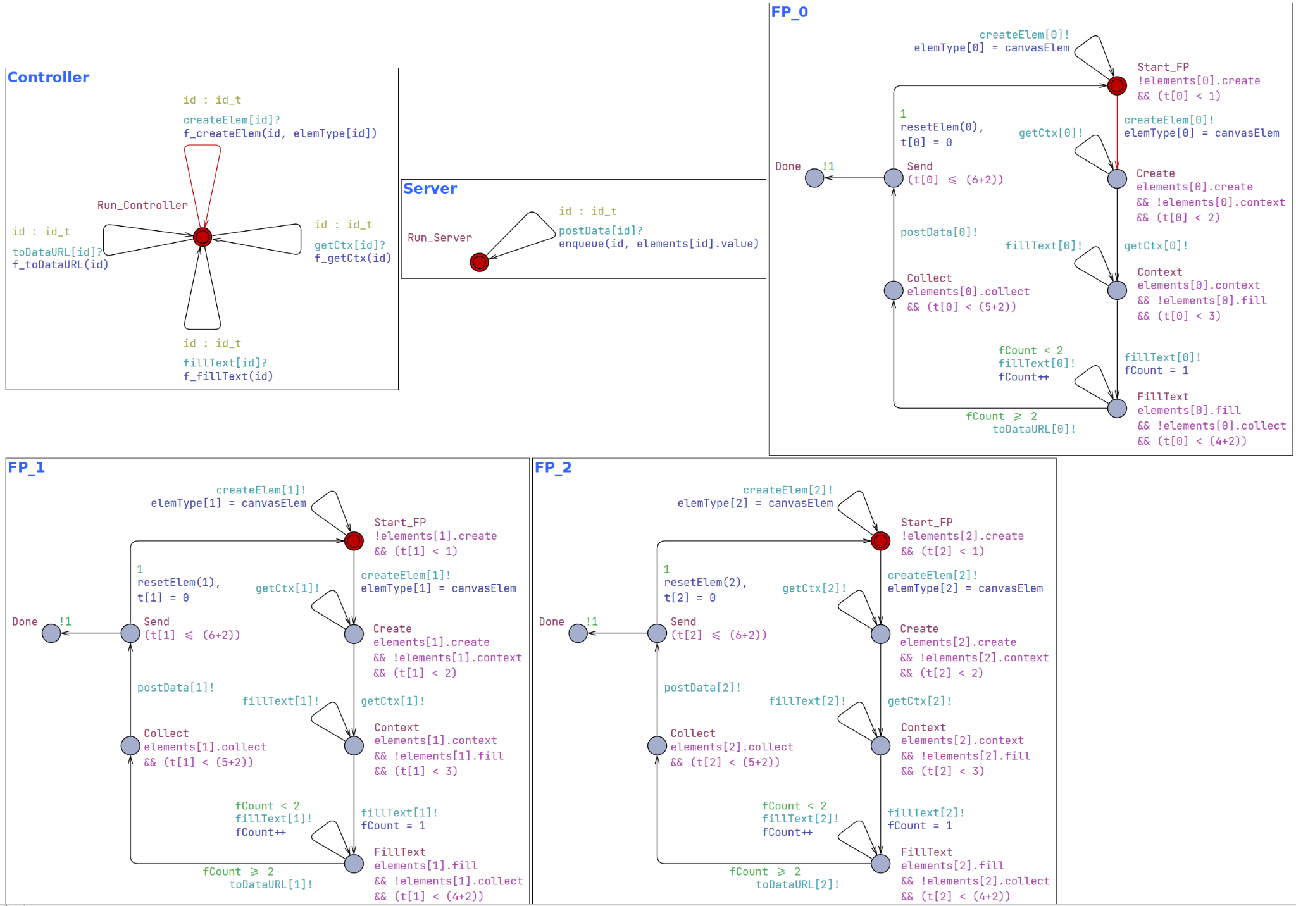

Slide 37
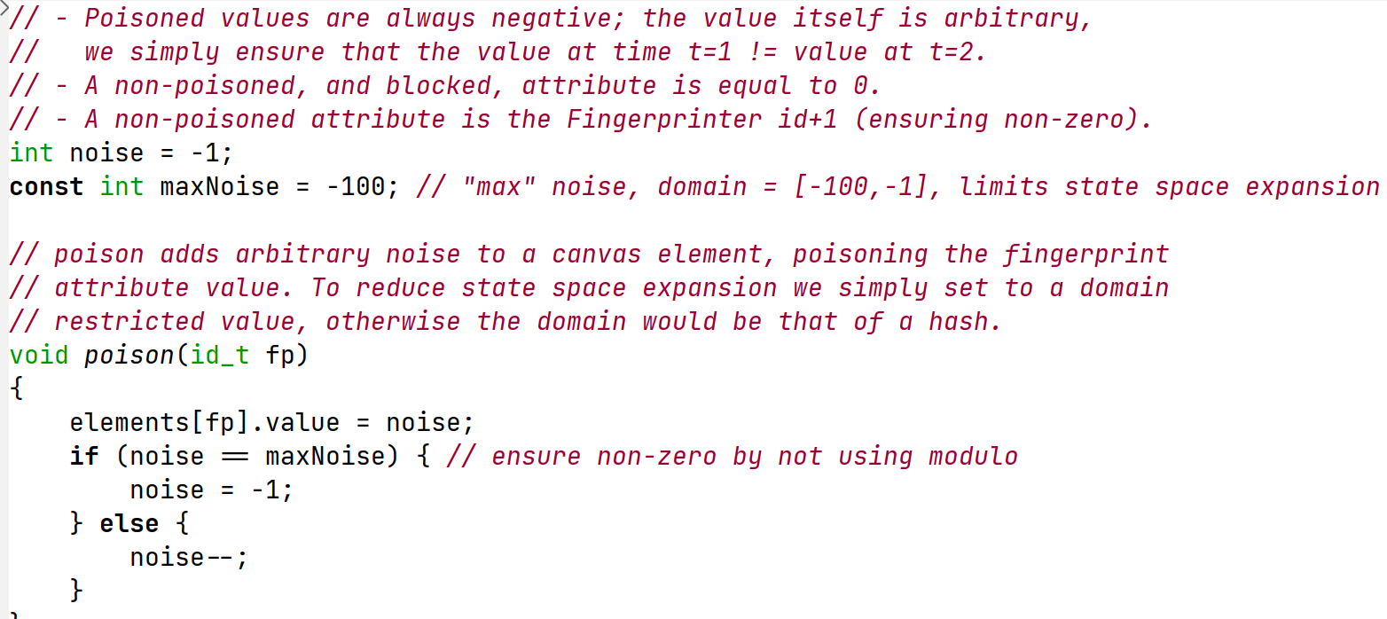
Code Snippet: Poisoner

Slide 38
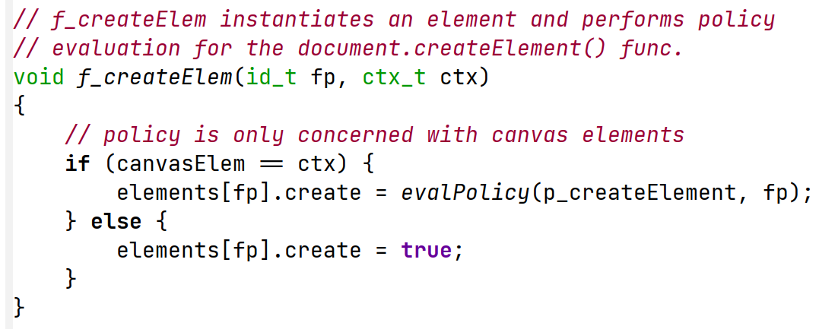
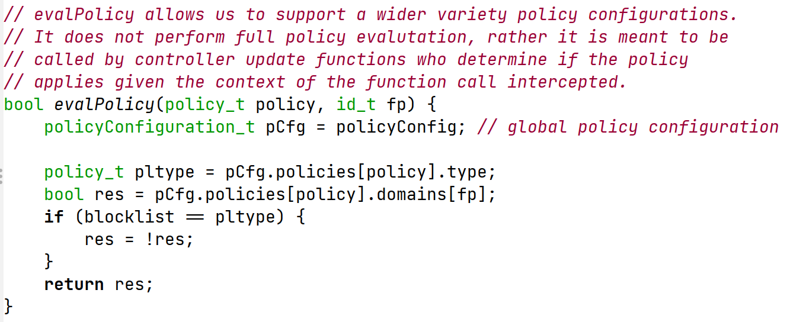
Code Snippet: Policy Evaluation

Slide 39
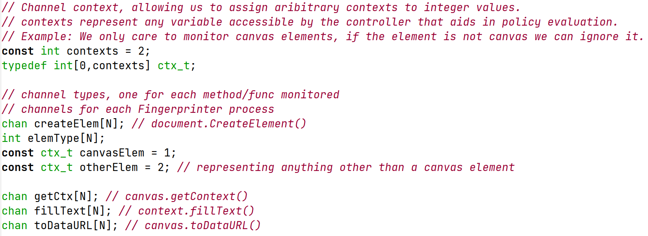
Code Snippet: Sync Channels

Slide 40
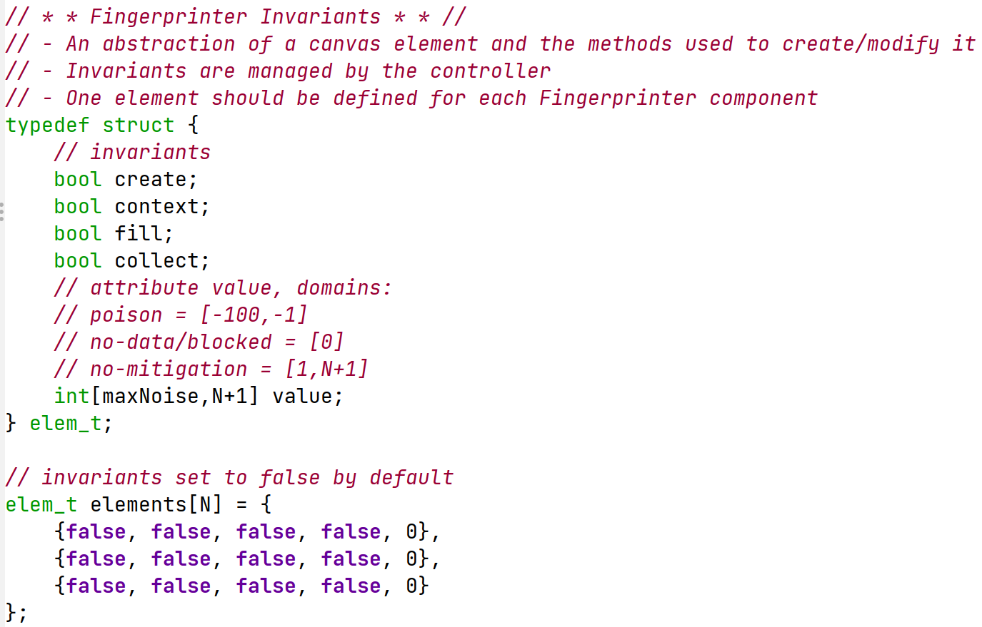
Code Snippet: Invariants

Slide 41
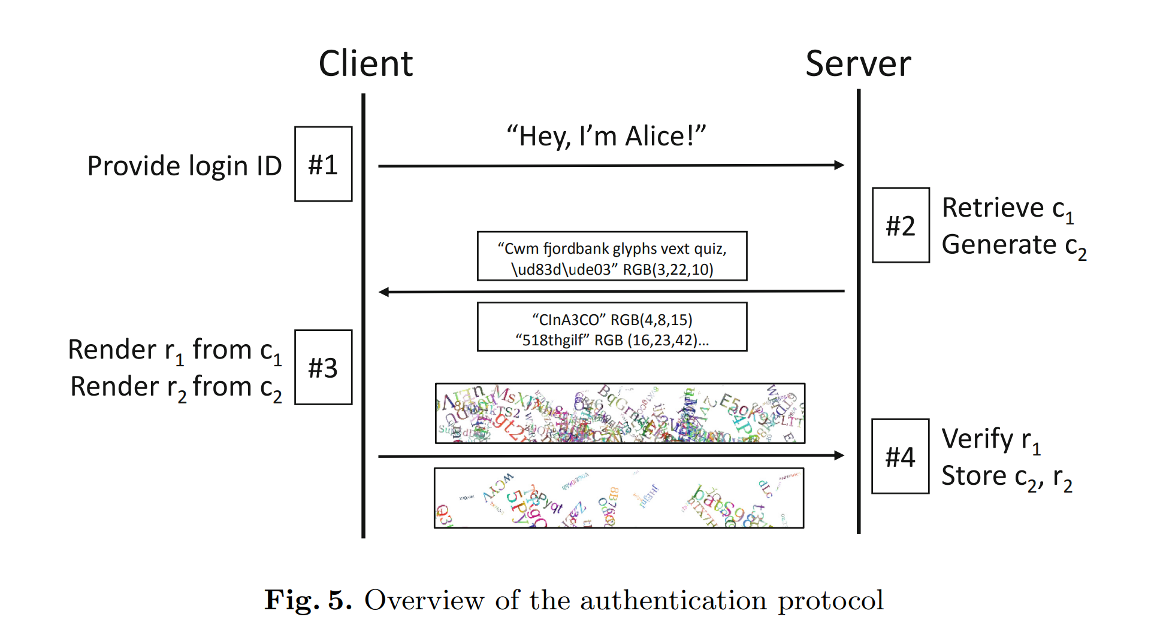
Benign Application Example
A challenge/response-based authentication mechanism proposed by Laperdrix et al. (2019).

Slide 42
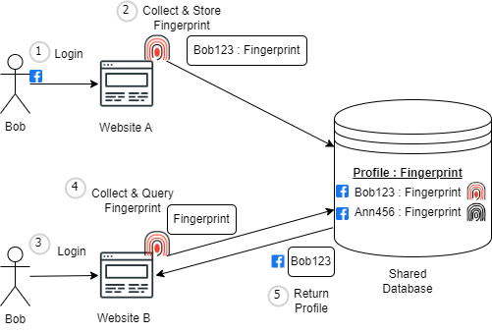
Malicious Application Example
Source: Khademi et al. (2015)

Slide 43
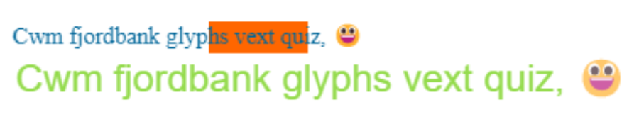
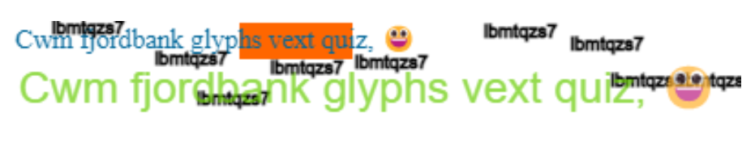
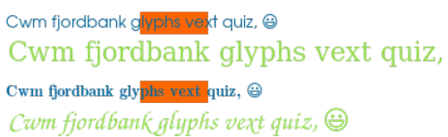
Canvas Poisoning Examples
Base Canvas Image
Poisoned Versions
Testing Tool Used: https://amiunique.org/
Source: Laperdrix et al. (2017)

Slide 44
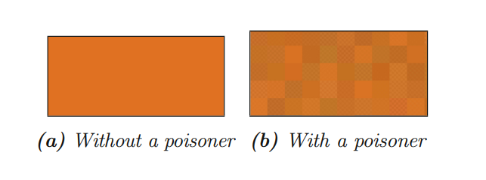
Canvas Poisoning Examples
Source: Laperdrix et al. (2019)

Slide 45
Computation Tree Logic (CTL) In UPPAAL
Source: UPPAAL Tutorial

Slide 46
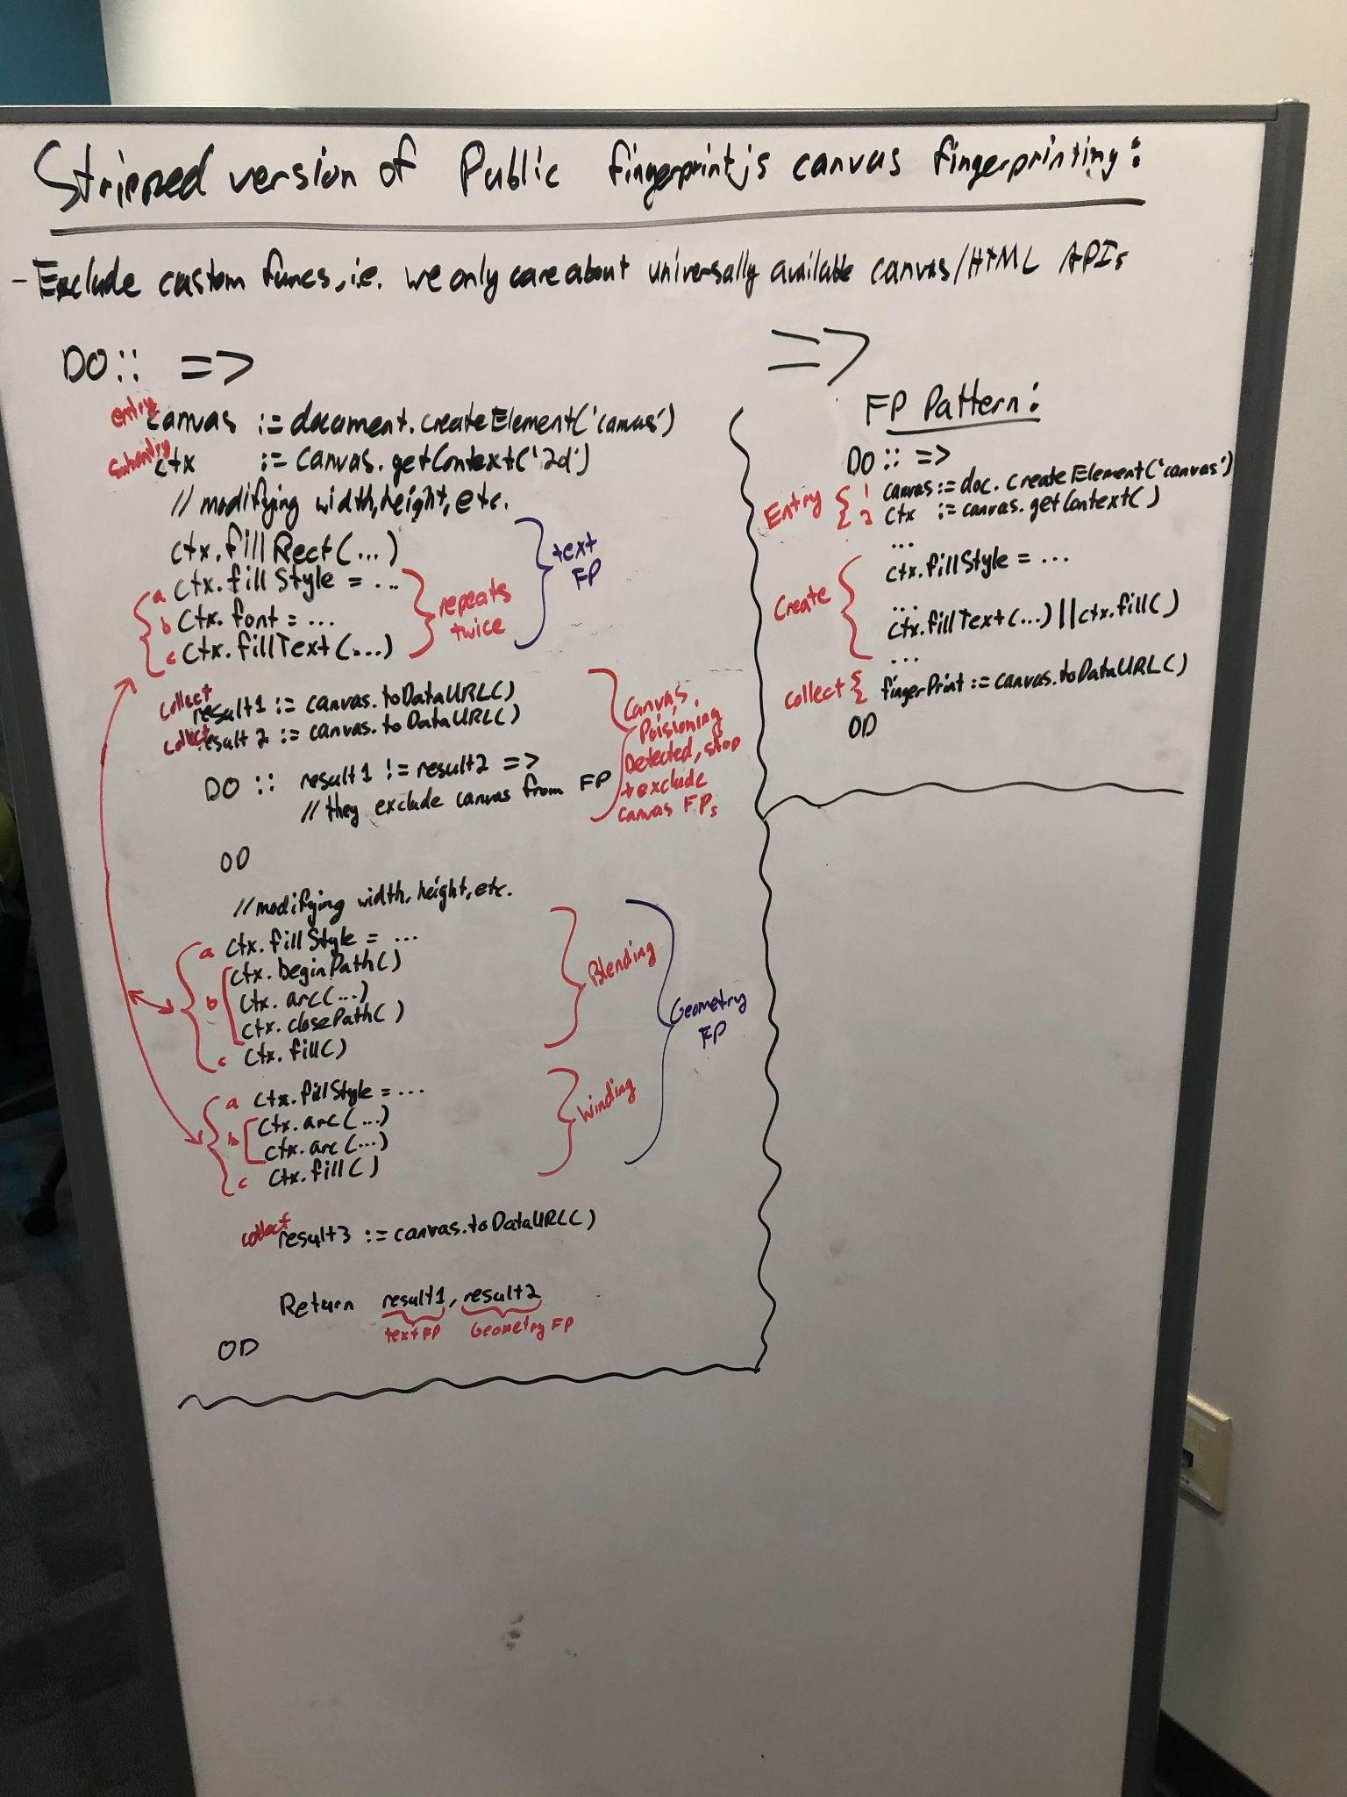
Abstracting Fingerprinting Scripts

